Slide 1



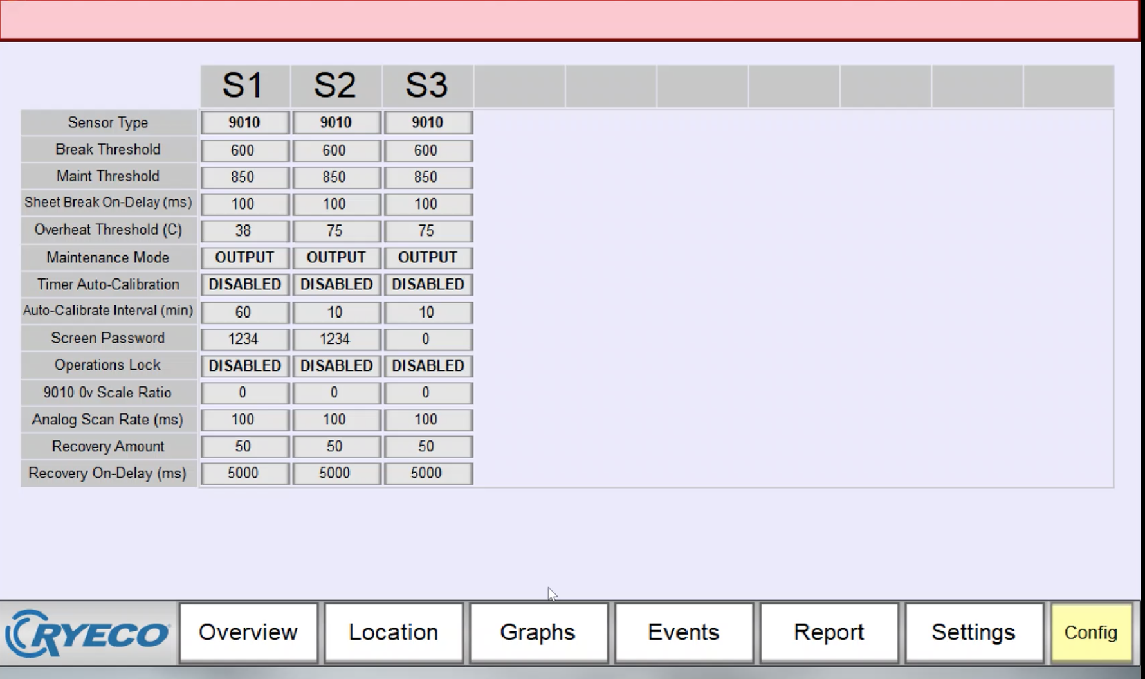
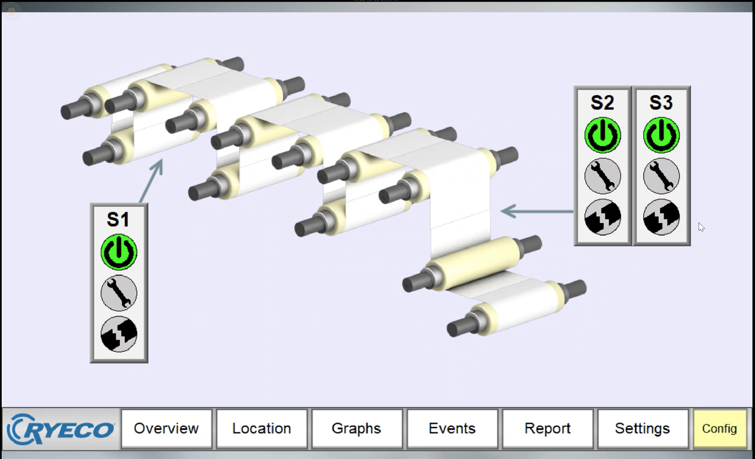


ONE-9010 Sheet Break Remote Monitoring
Introducing:
Monarch ONE-9010 remote monitoring
sheet break detection system
Real-time monitoring system
Monarch’s ONE-9010 remote monitors sheet break detection software sensors always and sends alerts to customer by email, or cell text* when an
event happens or maintenance is needed.
- Customer can control the events they want
to be notified on
- Customer can control who received the
event notifications
- Customer can control how the receive the
notifications (email/*text)
Events for notification
- Sheet Breaks
- Maintenance Alarm
- Sensor Overheat
- Sensor Disconnect
- Maintenance Needed
Support: Monarch 360 Support can go into the customers settings and pull reports, view history, able/enable bypass, and calibrate sensors.
Hardware: Cabinet with a screenless HMI that mill connects to internet via Ethernet
Customer Set up: Customer must run the ethernet wires and set up through their firewall
.
Real-time (live) events notification
- Bypass
- Temperature
- Signal Quality
- Calibration
The Monarch ONE‐9010 was engineered to address common technical issues in the field. The ONE‐9010 brings a solution to the most problematic issues in todays laser operated sheet break detectors
Remote monitoring
Monarch 360 Service team can remotely, along with mill personal (on-site), work though minor issues and troubleshoot to get you back online with minimal down time.
*text supported if your carrier supports sending text via emails
The Monarch ONE‐9010 software logs performance data and charts every second to know how your sheet break system
is performing
Copyright © 2021 Monarch, LLC. All Rights Reserved.

