Slide 1
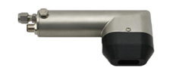
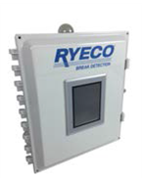
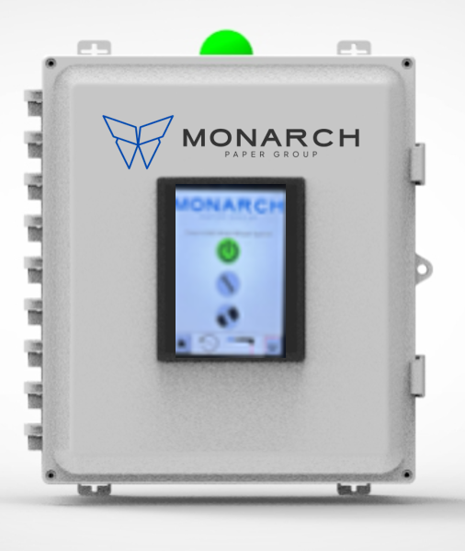


EXT-9003 Sheet Break Detection System
EXT-9003 Details
Monarch EXT-9003 Comparison
The EXT-9003 is a laser sensor used in any open draw location, while also able to handle a multitude of color changes on the fly. The stainless steel body, hard-coat anodized nose cone, high temperature cable and patented air purge allows this sensor to withstand any harsh environment. With a mounting distance of up to 5 ft this sensor is a tried and true Monarch product with hundreds of installations world wide
The Smart-Box is equipped with a smart controller that allows one-touch calibration, temperature monitoring and records the time of the last break. The HMI Touchscreen provides quick access for sensor calibration and information.
 | Monarch EXT- 9003 | Other Sensors
Any Environment | ✓ | ×
Patented Air Purge | ✓ | ×
Robust Housing | ✓ | ×
High Temp Cables | ✓ | ×
Temperature Monitoring | ✓ | ×
Operator Friendly | ✓ | ×
Break Logging | ✓ | ×
Application, Industry & Benefits
Industry:
Pulp
Paper
Tissue
Packaging
Applications:
Open Draw
Sheet on Cylinder
Tight spaces
Harsh Environments
Color Changes
Benefits:
5 ft. Detection
Patented Air Purge
Performance Data
Maintenance Alarm
Product | Product Image | Max Operating Temperature | Humidity | Air Consumption | Operating Voltage/Power Feed | Construction
EXT-9003 |  | 400˚ F (204˚ C) | 100% | 1 CFM (28.3 LPM) | 24 VDC | Stainless steel housing with hard-coat anodized aluminum nose cone
Smart-Box |  | 104˚F (40˚C) | 100% | - | 100-240 VAC (.5-1 amp) | Polycarbonate

